Slide 1



TCS CodeVita, IBM PYQ

Slide 2
1 · String Pair
MEDIUM
THE TASK
SAMPLE
Spell every number in English and count all the vowels: that total is D.
Count the pairs in the list whose sum equals D.
Print the pair count in words ("one", "two"...).
INPUT
OUTPUT
5
1 2 3 4 5
one
one(2) + two(1) + three(2) + four(2) + five(2) gives D = 9. Only 4 + 5 = 9.
100 is "hundred" (2 vowels), not "one hundred".
Output is in words. If the count is above 100, print "greater 100".
WATCH OUT
Notes:
Hook: this looks confusing, but it is two easy steps. Step 1: spell the numbers and count vowels to get D. Step 2: count pairs that sum to D using a frequency array. Warn about 100 being hundred and the words output.

Slide 3
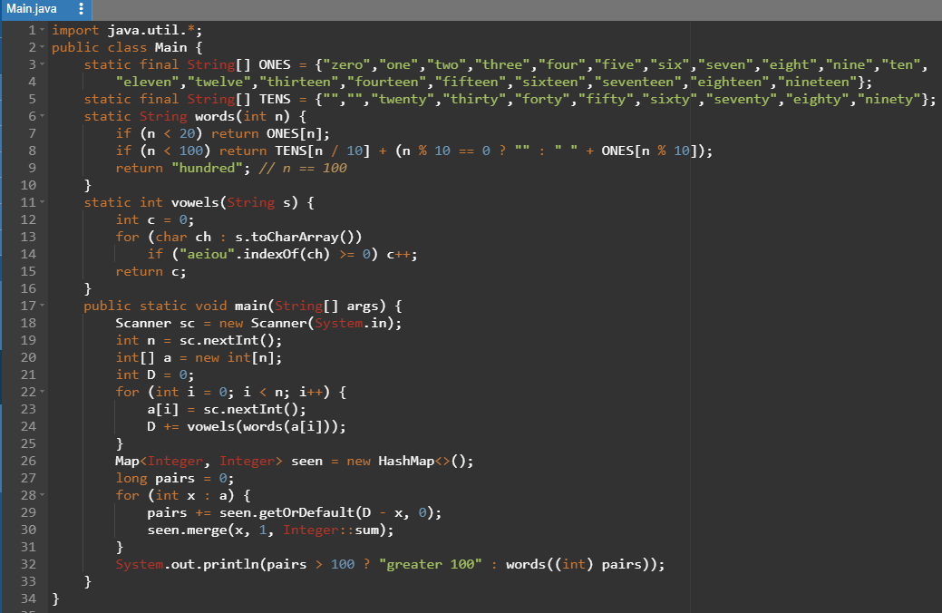

Slide 4
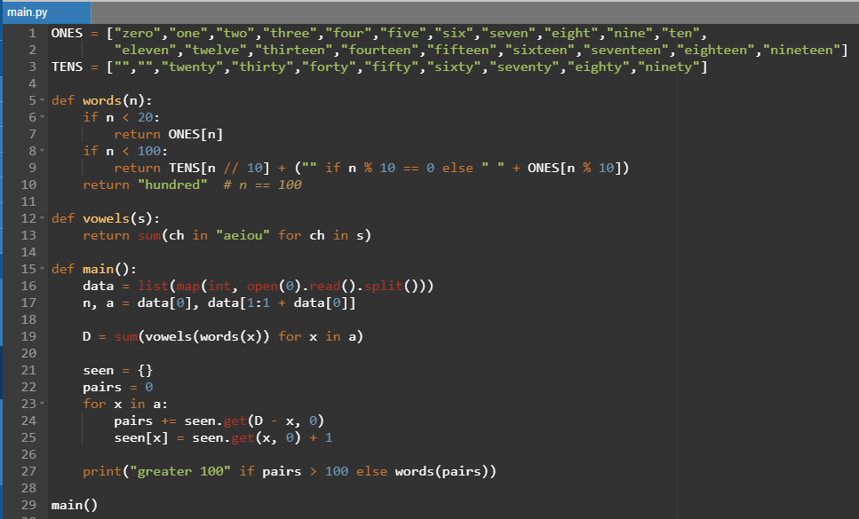

Slide 5
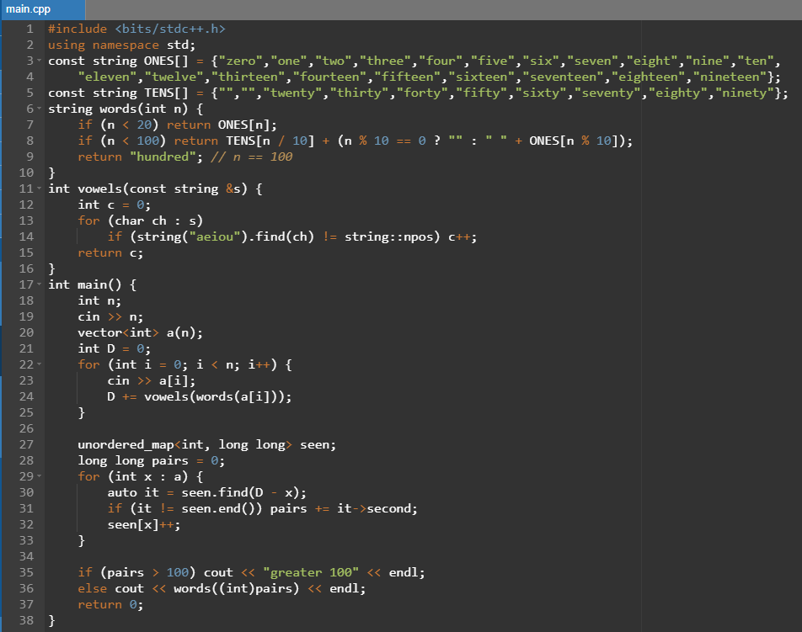

Slide 6

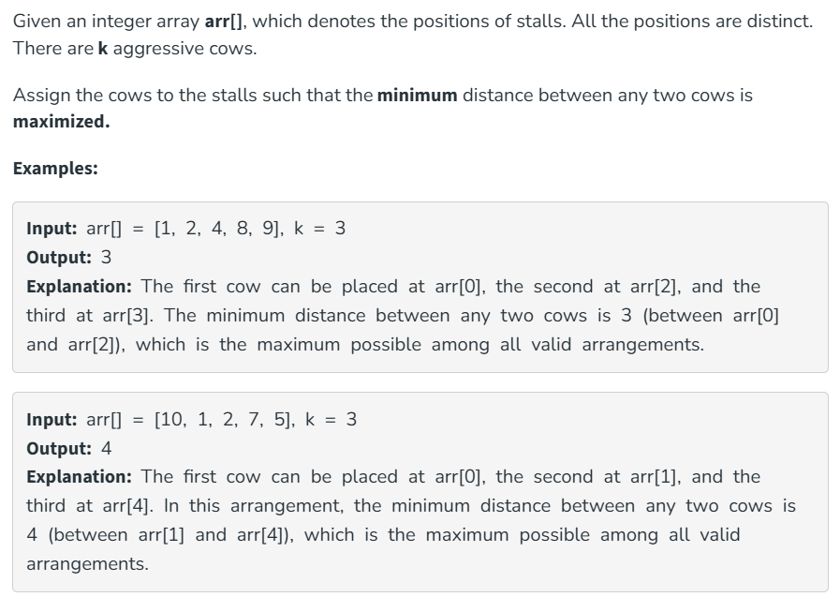

Slide 7
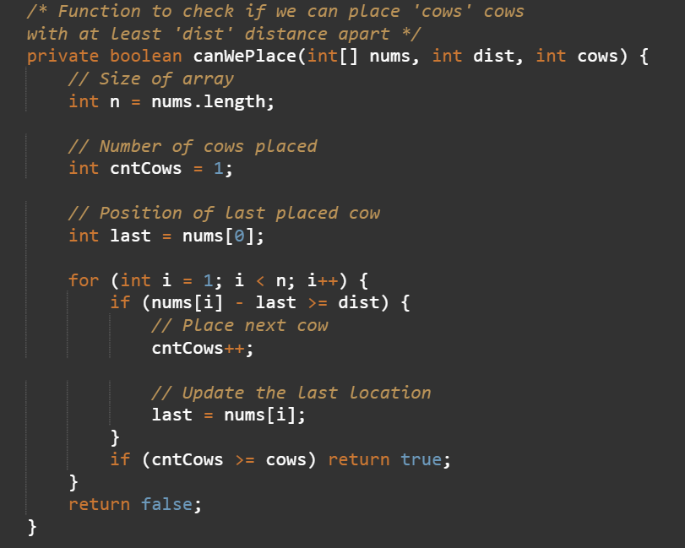
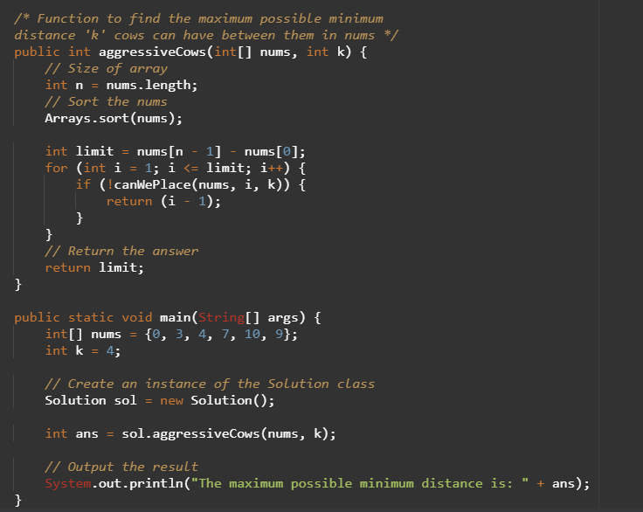

Slide 8
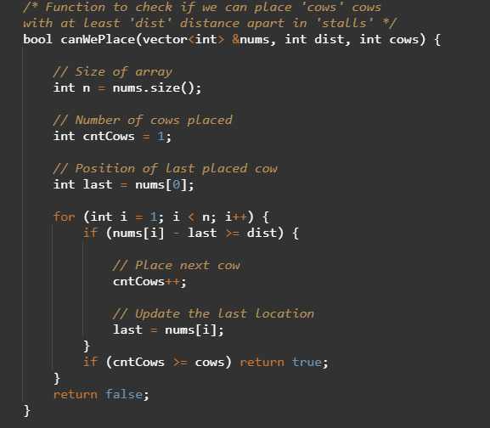
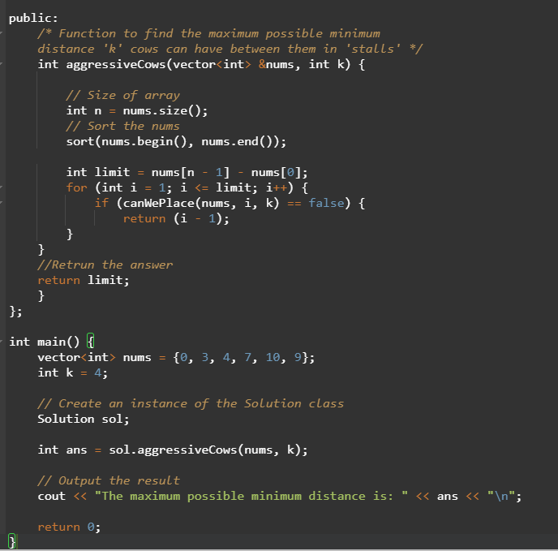

Slide 9
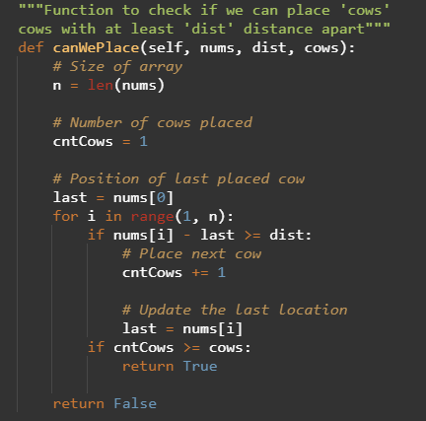
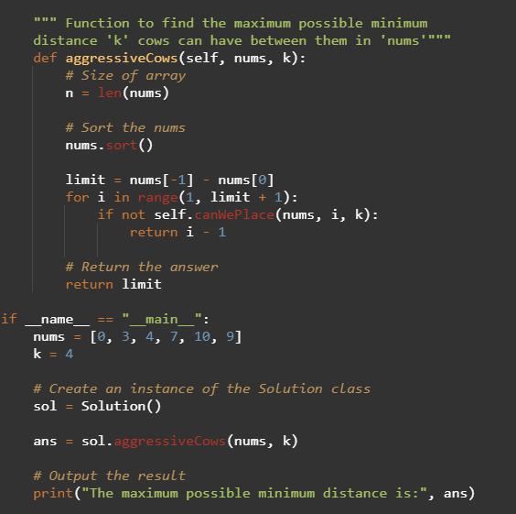

Slide 10
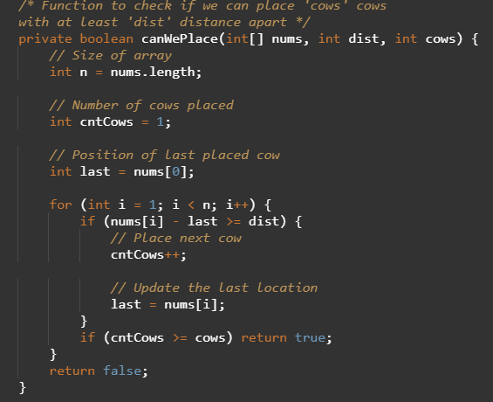
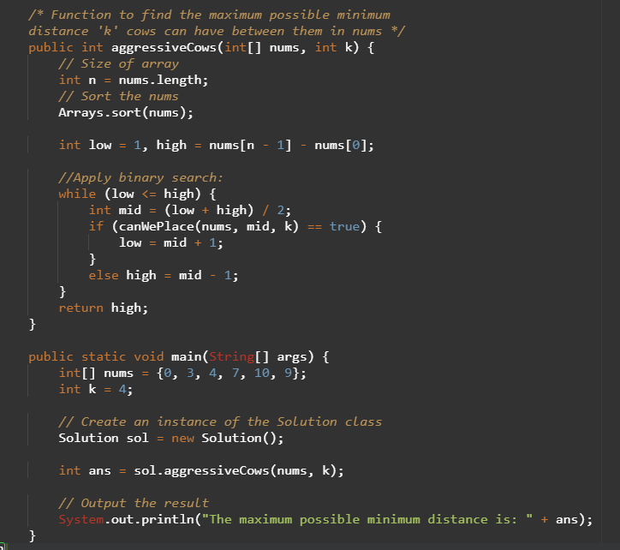

Slide 11
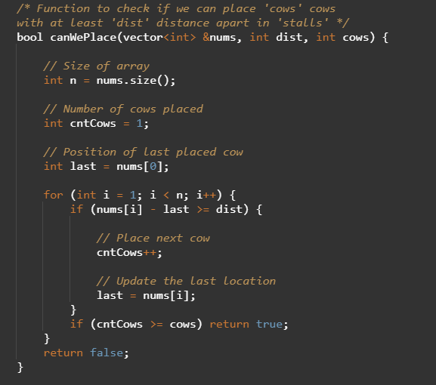
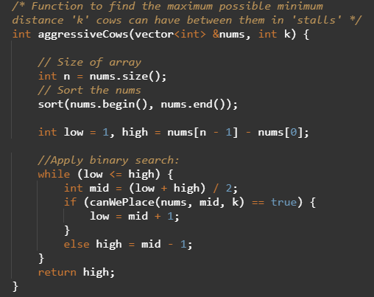

Slide 12


